Slide 1
Moment of a Force About an Axis (vector calculation)
Dr. Jacob Moore
Associate Professor of Engineering
Penn State Mont Alto

Slide 2
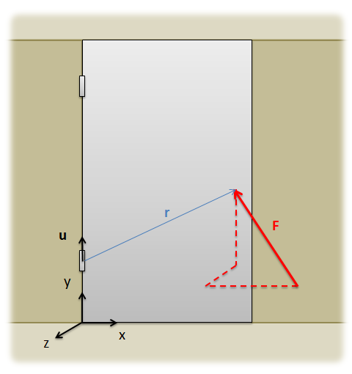
Moment of a Force About an Axis
Occasionally, we want to find the moment that a force exerts about a specific axis.
For example, the force shown in the diagram below will exert a moment about the bottom hinge (a point)
Some part of that moment will be about the axis of the hinges (the y axis)
Some part of that moment will be about other axes.

Slide 3
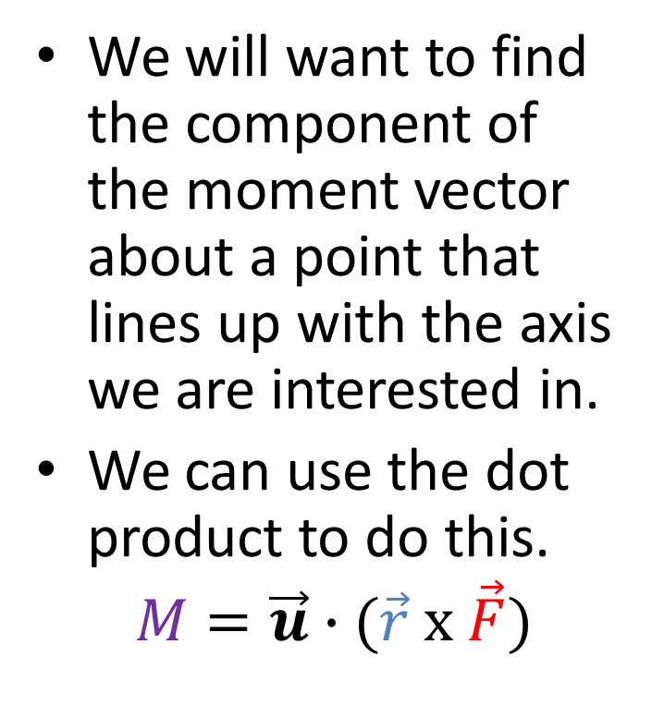
Moment of a Force About an Axis
We will want to find the component of the moment vector about a point that lines up with the axis we are interested in.
We can use the dot product to do this.
$$M=\vec{u}∙(\vec{r} x \vec{F})$$

Slide 4

Moment of a Force About an Axis
$$M=\vec{u}∙(\vec{r} x \vec{F})$$
A unit vector along the axis we are taking the moment about
The force vector
A vector going from any point on the axis we are taking the moment about to any point on the line of action of the force

Slide 5
The Dot Product
Like the cross product, the dot product can be calculated by hand or calculated with computer tools.
Unlike the cross product, the dot product results in a single scalar value.
This value represents the magnitude of the moment about the given axis.
The moment direction is specified by the vector u.

Slide 6
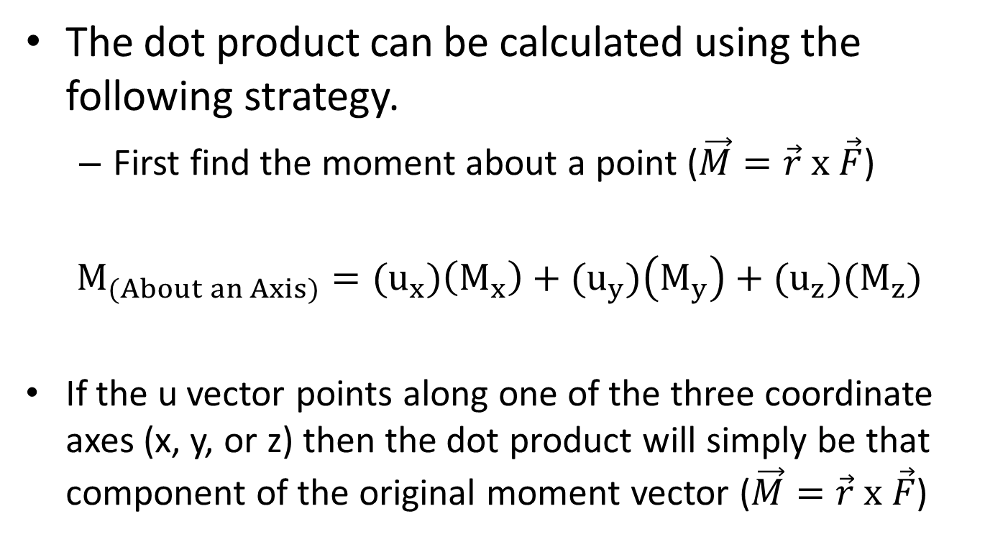
The Dot Product
The dot product can be calculated using the following strategy.
First find the moment about a point ($\vec{M}=\vec{r} x \vec{F}$)
$$M_{(About an Axis)}={(u}_{x})\left(M_{x}\right)+{(u}_{y})\left(M_{y}\right)+{(u}_{z})(M_{z})$$
If the u vector points along one of the three coordinate axes (x, y, or z) then the dot product will simply be that component of the original moment vector ($\vec{M}=\vec{r} x \vec{F}$)

Slide 7
Thanks for Watching
See other engineering mechanics videos and access the full tool at…

Slide 8
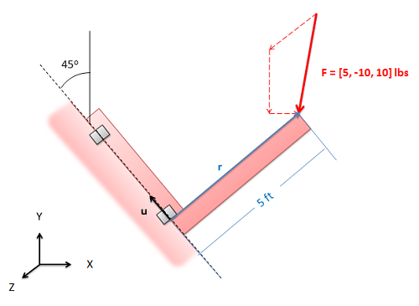
Moment About an Axis Worked Example
An L shaped plate lies in the XY plane and is supported by hinges at one end. Determine the moment that the force exerts about the axis of the hinges.

